Slide 1

Information Security Officer's
Advisory Group
WELCOME TO THE Dec. 3, 2025 ​
ISOAG MEETING​
Notes:
Title slide - Any text that looks black is HEX code 414042. If you have an idea for an image, let me know and I can provide you with one.

Slide 2

Agenda Presenter
Welcome/Opening Remarks | Kendra Burgess/ VITA
TEEM (Mentor Program) | Bobby Keener/CTEWorkforce
Workforce Password Management | Cooper Keating / SAIC Luis Lugo/VITA
What to Expect During an Incident Response | Jim Sturdevant / VITA
MSS Update | Mike Watson / VITA
Announcements and Upcoming Events | Kendra Burgess/ VITA
Adjourn
vita.virginia.gov
Notes:
This slide background works best with text heavy sections, with no imagery OR when an Icon is used

Slide 3



Technology Engagement with Mentoring™
Professional Mentor Overview
Presented to: Virginia ISOAG Meeting
December 3, 2025

Slide 4






Overview
People can deliver amazing results when given the right opportunity and support.
The Commonwealth Cyber Initiative (CCI) and CTEWorkforce (CTE) have partnered to deliver the Technology Enabled Engagement with Mentoring (TEEM) program.
CCI supports student career readiness via various experiential learning opportunities.
The TEEM experiential learning program places students with a cyber professional for a limited, structured 1-to-1 mentoring engagement.
The process and program outcomes provide value to both student mentees and the professionals.
CTE and the TEEM program were awarded the CCI 2025 Impact award.
Copyright 2025 CTEWorkforce – A Coronet Technology Enterprises Company

Slide 5

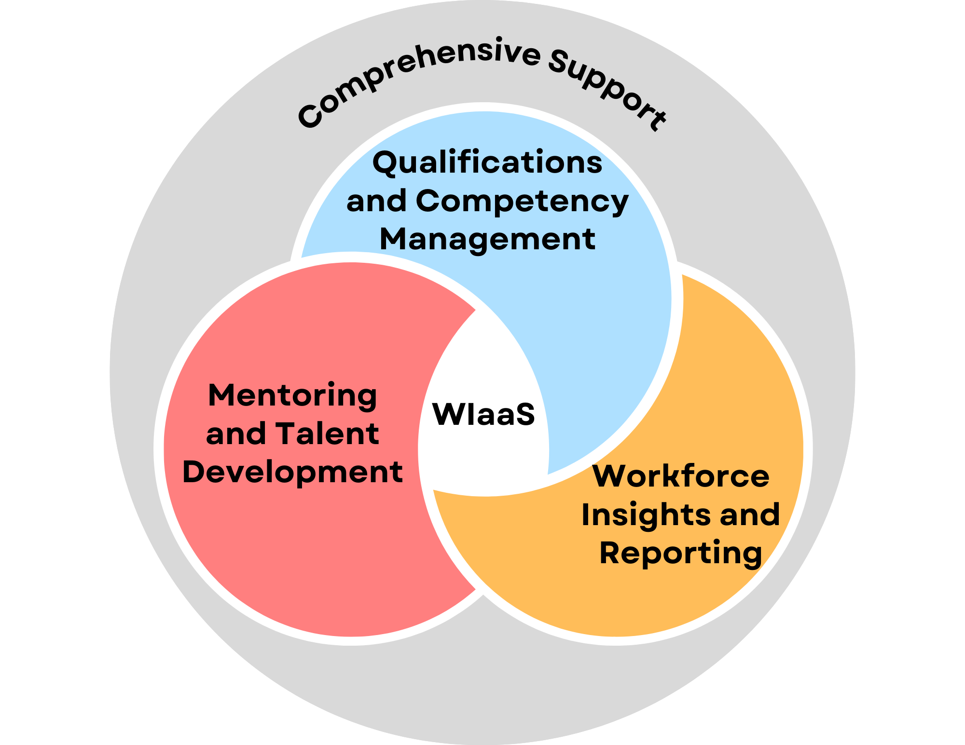

The Platform
TEEM is driven by the WIaaS talent optimization platform, an AI-driven, software solution that can powers workforce development initiatives via:
Qualifications & Competency Management
Mentoring & Talent Development
Workforce Insights and Reporting
Comprehensive Support
Copyright 2025 CTEWorkforce – A Coronet Technology Enterprises Company
Copyright 2023 CivilianCyber LLC – A Coronet Technology Enterprises Company

Slide 6
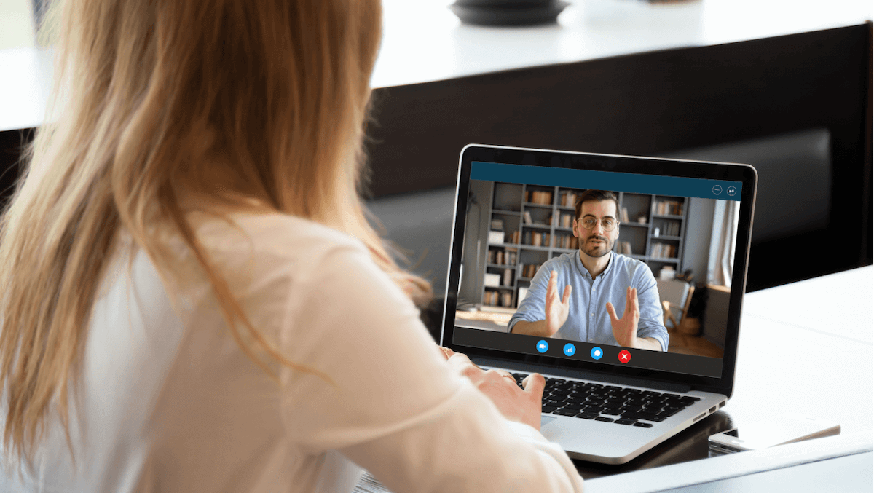
How TEEM Works
TEEM is a mentee-driven, experiential learning program…
  Professionals meet with college cyber student mentees
  Limited to six weekly, one-hour, 1-to-1, mentoring sessions
  Students drive the entire discussion
  Mentors simply show up and provide feedback
  Feedback, takeaways, survey data, etc. are captured
Copyright 2025 CTEWorkforce – A Coronet Technology Enterprises Company
Copyright 2023 CivilianCyber LLC – A Coronet Technology Enterprises Company

Slide 7

Students gain…
Career Exposure
Real-world Knowledge
Professional/Soft Skills Development
Structured Mentoring
Networking with a Cyber Professional
Copyright 2025 CTEWorkforce – A Coronet Technology Enterprises Company
Copyright 2023 CivilianCyber LLC – A Coronet Technology Enterprises Company

Slide 8
Mentor Expectations
Meetings
For six weeks, provide 1 hour per week for meeting/mentoring sessions.
Discuss
Answer standardized questions (asked by the student) during sessions about practical implementations of cybersecurity practices.
Feedback
Provide professional/soft skills feedback during sessions.
Suggestions
Upon program completion, provide short feedback or suggestions regarding the student and the experience.
Be Professional
Act in a professional manner.
Copyright 2025 CTEWorkforce – A Coronet Technology Enterprises Company
Copyright 2023 CivilianCyber LLC – A Coronet Technology Enterprises Company

Slide 9

Why Mentor?
An opportunity to share your experience.
Because TEEM removes the reasons not to…
  No Special Preparation
  Limited Timeframe
And because it helps…
  Build leadership skills
  Give back to the next generation
  Gain exposure to a vetted talent pipeline
It’s as easy as just showing up.
Copyright 2025 CTEWorkforce – A Coronet Technology Enterprises Company
Copyright 2023 CivilianCyber LLC – A Coronet Technology Enterprises Company

Slide 10
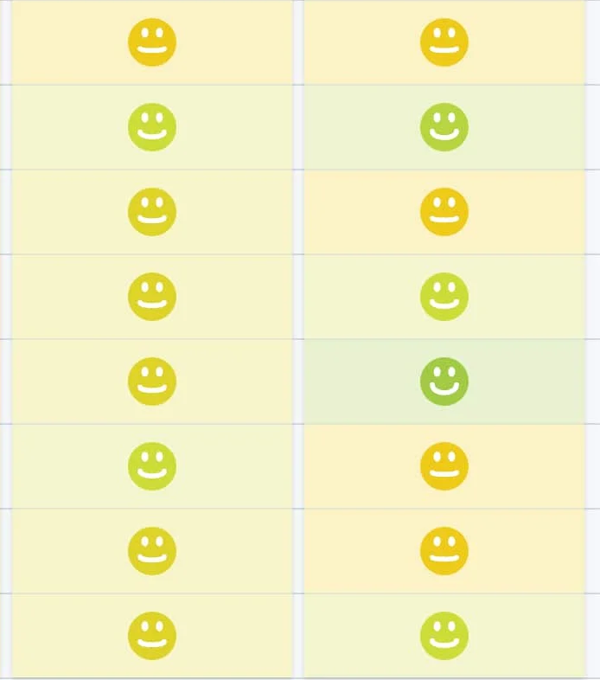
TEEM Feedback
Developed in partnership with CCI, TEEM has been deployed to hundreds of high school and college students.…
“Participating in this program will alter my future by enhancing my leadership skills and experience, defining what it means to be an administrator or program lead and helping me comprehend the basics of cybersecurity.”
– Student Participant
“This was a wonderful experience. My mentee was great and personally rewarding to positively impact not only her technical growth but to also provide professional and career advice. The program made it easy for me to be a mentor and I will recommend it to my professional colleagues!”
– Mentor Participant
Aggregate student confidence feedback increase from 2.5/5 to 4.5/5.0.
High repeat mentor and school participation rates.
Copyright 2025 CTEWorkforce – A Coronet Technology Enterprises Company
Copyright 2023 CivilianCyber LLC – A Coronet Technology Enterprises Company

Slide 11
Apply to be a TEEM Mentor...
https://cteteem.com/
- Or -
Contact Morgan…
morgan@cteworkforce.com
For More Information…
Copyright 2025 CTEWorkforce – A Coronet Technology Enterprises Company

Slide 12
Workforce Password Manager (WPM)
Cooper Keating
Program Analyst
Stephen Peck
Program Applications Lead
Dec. 3, 2025

Slide 13
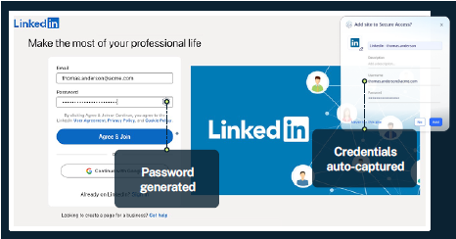
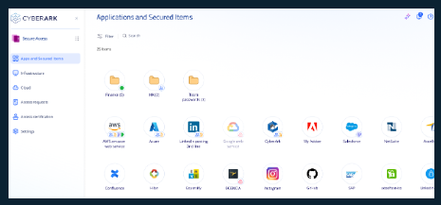
What is a password manager?
A password manager is a secure and scalable solution designed to manage and protect employee passwords across an organization. It offers a centralized platform for storing, sharing and auto-filling credentials while enhancing productivity and reducing the risks associated with weak or reused passwords.

Slide 14
CyberArk Workforce password manager (WPM)
Why CyberArk WPM?
  Overcomes the authentication and auditing challenges presented by business applications (apps) requiring individual usernames and passwords. (e.g. writing credentials on a sticky note)
  In addition to credentials, WPM can also secure text-based items such as serial numbers, licenses, personal identification numbers (PINs) or other secrets
Mitigate credential-based attacks:
Prevent unauthorized access by securing passwords in a vault with industry leading encryption
Eliminate password frustration for end users:
  Enable effortless logins and intuitive user interfaces(IUI) with auto-fill capabilities and one-click app access
Ensure IT visibility and control:
  Gain oversight of access and sharing, enforce policies and prevent the use of compromised credentials
  Measure and track risk posture:
  View password insights, access reports and asses and address risks
Seamless integration:
  Extend identity security beyond passwords with CyberArk’s broader security ecosystem

Slide 15
Important information
Who should leverage CyberArk WPM?
  All agencies should leverage WPM as it provides risk mitigation around password and secret management
  Agency will have a WPM administrator that can control access within the agency, allowing more autonomy for each agency
When will it be available?
WPM is going through the service portfolio life cycle management (SPLM) process with a release date of Dec. 1
Where to find more information?
  There will be knowledge base articles and user guides in the VITA knowledge base
  If you have any questions before those are posted, contact Cooper.w.Keating@SAIC.com
What is the service cost?
  $4.18 per user per month

Slide 16
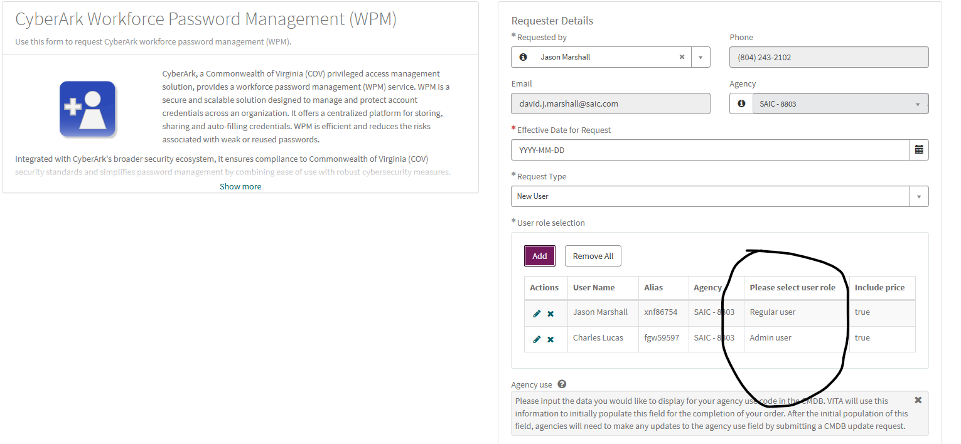
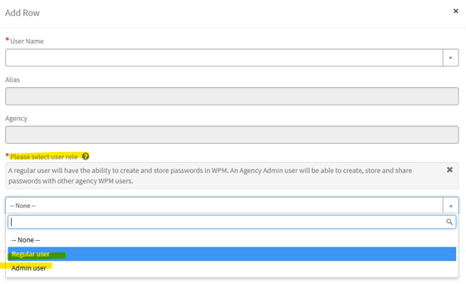
How do I get WPM?
WPM will be available in the VITA service catalog.

Slide 17
Available resources
WPM frequently asked questions (FAQ) (KB0020361)
  This FAQ includes the questions and responses from the November AITR meeting
WPM user guide (KB0020360)

Slide 18
Questions?

Slide 19


Incident Response
What to Expect During an Incident Response
Jim Sturdevant
SLED SOC Manager
Notes:
Example of when to use this slide background for a call out section and text

Slide 20
MSS Contract Update
Michael Watson - CISO
Notes:
No image title slide - Any text that looks black is HEX code 414042.

Slide 21


MSS RFP process is complete - Contact awarded
Contract Overview
  5 year contract w/extensions
  2 sections
    security engineering
    Security operations center
Zero Trust Strategy Aligned
  Security tool upgrades target for CY2
  Automation
  Analytics
  Telemetry data
SOC Fully Migrates to Splunk
  Update use cases
  Enhance automation
Notes:
Example of when to use this slide background for a call out section and text

Slide 22
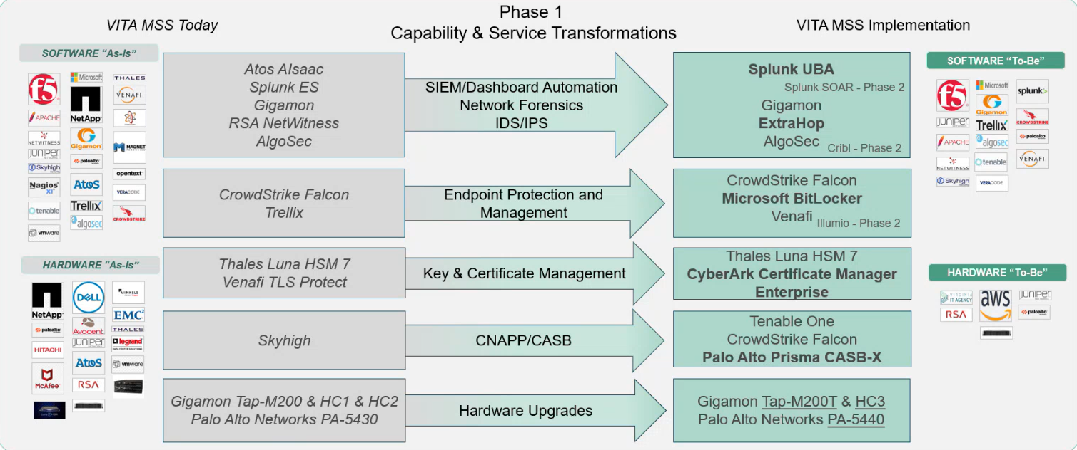
Tool Transition Overview (Subject to Change)

Slide 23

Announcements
ISOAG December 2025
Notes:
Example of when to use this slide background for a call out section and text

Slide 24


Top 5 Vulnerabilities
For the month of December, the Top 5 Key Vulnerabilities are:
Google Chrome < 142.0.7444.175 Multiple Vulnerabilities
Oracle Java SE Multiple Vulnerabilities (October 2025 CPU)
Microsoft .NET Core SEoL
Microsoft Teams < 1.6.0.18681 RCE
VLC < 3.0.21 DoS
*NOTE* Check CSRM Connections for more detailed information
vita.virginia.gov
Notes:
This slide background works best with text heavy sections, with no imagery OR when an Icon is used

Slide 25
Deliverables & dates for audit and risk compliance
Agency deliverable activity & schedule for 2025
For any questions, please have your ISO contact your assigned CSRM analyst or Erica Bland, the Governance & Compliance Manager.
Annual report data will be pulled on December 31, 2025.
CSRM will accept CY25 deliverables until January 31, 2026.
Quarterly updates Audit & Risk Findings
Review and update Audit & Risk Plans as required
Complete Audit & Risk Assessments as required
Review & Update Business Impact Analysis & application certifications
Agency ISO need to complete their ISO certification requirements
Annual report data will be pulled on December 31, 2025.

Slide 26

SAT Training deadline
Notes:
Title slide - Any text that looks black is HEX code 414042. If you have an idea for an image, let me know and I can provide you with one.

Slide 27
NCSR Assessment Update
We are currently working on the NCSR (Nationwide Cybersecurity Review) assessment within the Archer platform.
As we finalize the tools and resources for the self-assessment process, we will share further instructions and updates to guide you through the next steps.
Thank you for your patience and continued engagement. More information will be provided soon.

Slide 28
Upcoming Events
vita.virginia.gov
Notes:
This slide is used as a transition title slide for a new section

Slide 29

Governance Office Hours Announcement
Governance Office Hours launch recently – a dedicated space for Agency ISOs and teams to bring their questions, concerns, or ideas directly to the Governance Team.
What to Expect:
Open discussion place
Governance Updates
Q&A and support for your needs
Next Session:
December 10th, 2025 | Microsoft Teams
[Click here to register for the meeting]
Let’s work together to strengthen governance across the Commonwealth!
Notes:
Example of when to use this slide background for a call out section and text

Slide 30

Service Tower SOC Report Review Sessions
      To register for this meeting, please click on the link below: https://covaconf.webex.com/weblink/register/r4a05e20b703d317948bbc133e6645dd8
The upcoming SOC review session is December 11, 2025, and will be held remotely.
Please register at the link below
Notes:
Example of when to use this slide background for a call out section and text

Slide 31

IS Orientation
The next IS Orientation is being held on December 11, 2025
  December 11th, from 9am to 4pm, registration closed Dec 1st
  Last IS Orientation of 2025
  It will be held in-person at the Boulders location:
  7325 Beaufont Springs Drive, Richmond, VA 23225
  Visit Commonwealth IS Orientation to register!
Notes:
This slide works best with photos and graphs/charts. Image and text can be reversed

Slide 32
MEETING ADJOURNED
Notes:
Title slide - Any text that looks black is HEX code 414042. If you have an idea for an image, let me know and I can provide you with one.

Slide 33
Welcome to the December 3, 2025
ISOAG Meeting
Information Security Officer’s
Advisory Group
Notes:
No image title slide - Any text that looks black is HEX code 414042.

